Slide 1
Machine Learning

Slide 2
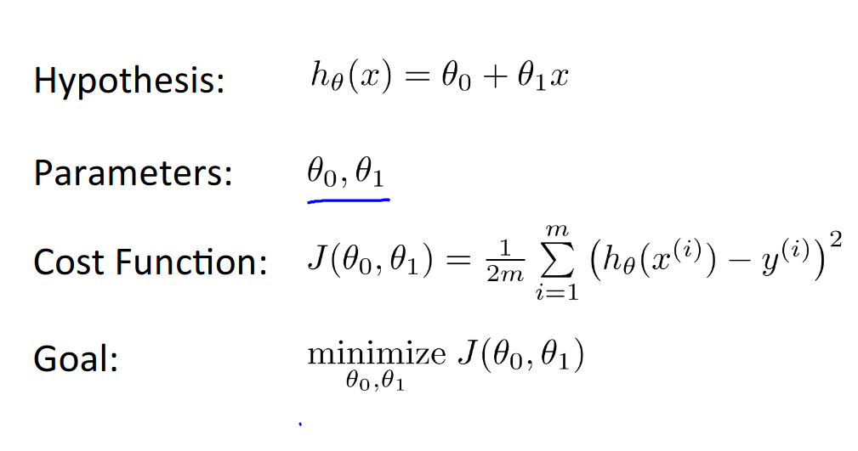
Learning Parameters & Gradient Descent

Slide 3
Learning Parameters & Gradient Descent
So we have our hypothesis function and we have a way of measuring how well it fits into the data. Now we need to minimize the parameters in the hypothesis function in the way to minimize the cost function, and for that we need Gradient Descent.
Gradient Descent: it's not just for Linear Regression Problems but you ll see a lot in Machine Learning in different Algorithms and Model.
how it works:
Start with random values of theta 0 and theta 1
Keeping changes theta 0 and theta 1 to reduce the cost function J
until we hopefully end up at global a minimum

Slide 4
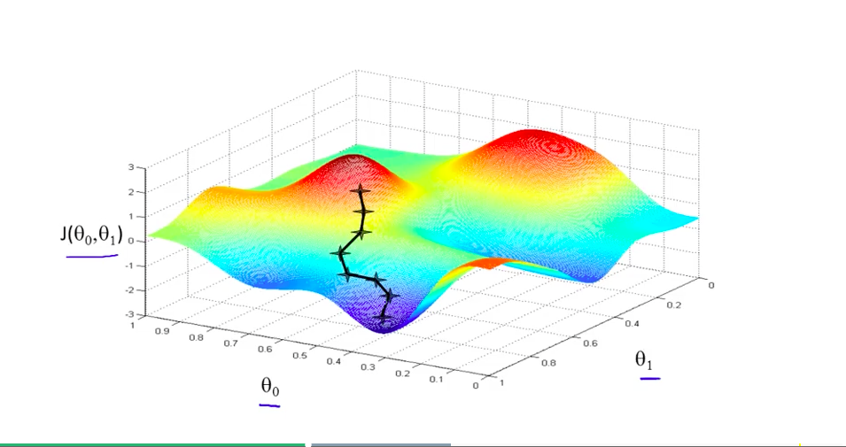
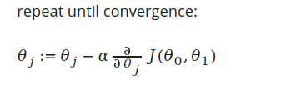
Gradient Descent Equation & Alpha α
The size of step you take to minimize the cost function is important so another parameter we will deal with is Alpha α so increase α will increase the step you take and vice versa.
:= Assign Operator
α Learning Rate
beside Alpha is the derivative of the cost function.
The two Parameters are updated simultaneously.

Slide 5
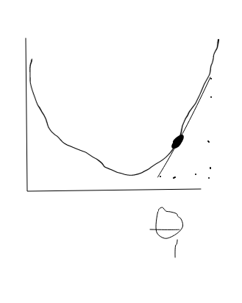
Gradient Descent Equation & Alpha α
How it works:
You should noticed that with different slope (positive like this image Theta will decrease and if it negative then Theta will increase which at the end try to minimize the cost function and the size of step you take in increasing or decreasing Theta will be affected by Alpha if its large then will be decreasing quickly but with less optimization.

Slide 6
NOTE !
“we should adjust our parameter α alphaα to ensure that the gradient descent algorithm converges in a reasonable time. Failure to converge or too much time to obtain the minimum value imply that our step size is wrong.”

Slide 7
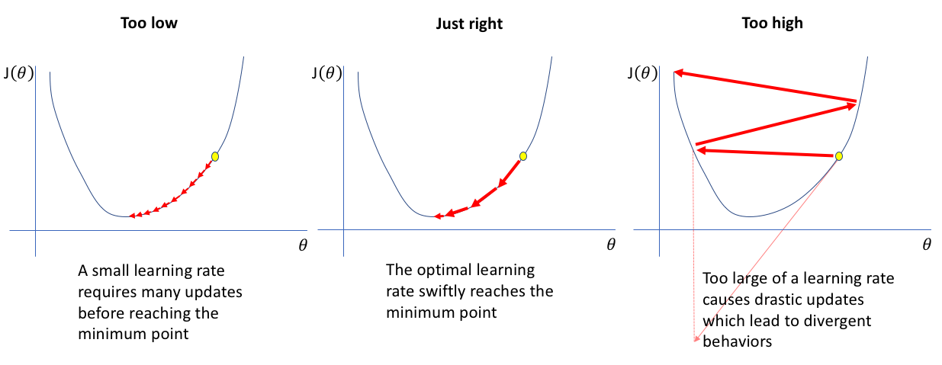
Alpha Effect !

Slide 8
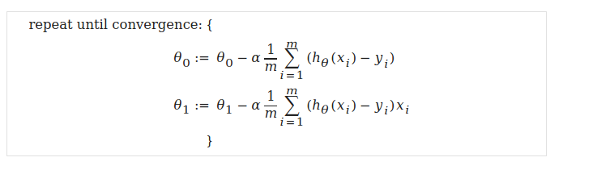
Gradient Descent For Linear Regression
M is our training example
α the Learning rate
θ₀and θ₁ will changed simultaneously
h(x) our hypothesis function which =h(x)= θ₀ + θ₁x
Y is real output
X is the feature of each example

Slide 9
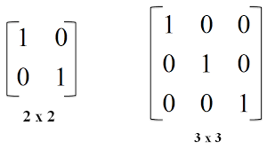
Linear Algebra
Terminology
A_{ij} = to the element in the i-th row and j-th column of matrix A.
A vector with 'n' rows is referred to as an 'n'-dimensional vector.
v_{i}​ = the element in the ith row of the vector.
Scalar = single number not vector or matrix like 3
T Matrix Transpose
Dot Matrix Multiplication
A⁻¹ Matrix inverse
Matrix & Vector
Can we generate vector from this …!

Slide 10
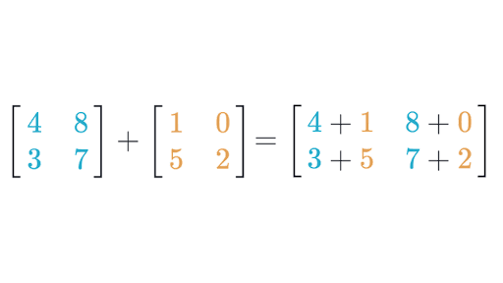
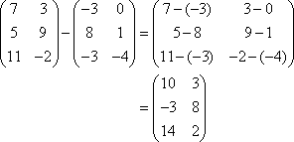
Matrix Addition & subtraction
NOTE !
Should the two Matrix A and B of same dimension.
The output Matrix also of the same dimension.
Matrix Addition
Matrix subtraction

Slide 11
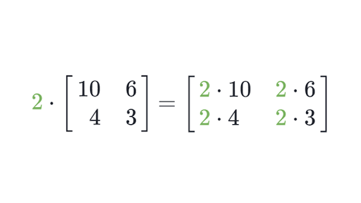
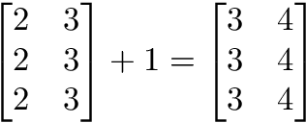
Scalar Matrices
NOTE !
Scalar is a number that can be apply to matrix in different way like Multiplication, Addition, subtraction & division

Slide 12
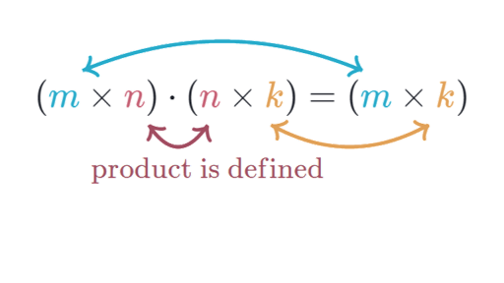
Matrix Multiplication OR called Dot Multiplication
NOTE !
The second number of columns of first matrix should equal to first number of rows in second matrix .
A = 3*4 should B = 4*3

Slide 13
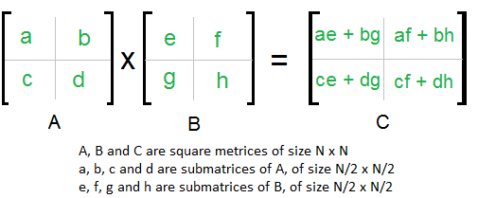
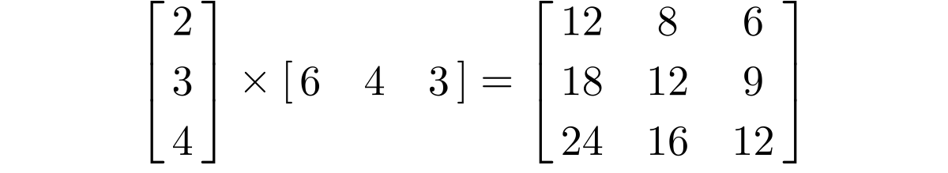
Dot Multiplication Example

Slide 14
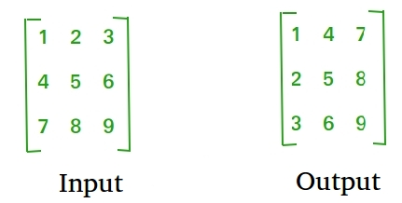
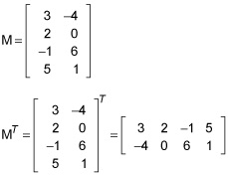
Matrix Transpose

Slide 15
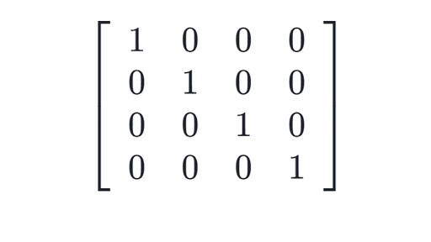
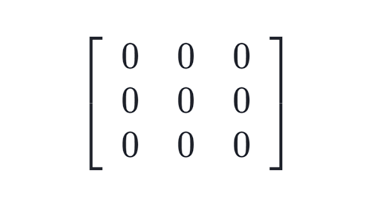
Zero & Identity Matrix
NOTE !
Identity Matrix Multiplication is equal to the matrix that multiply by

Slide 16
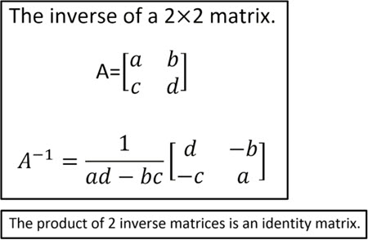
Matrix Inverse
NOTE !
The product of the matrix and its inverse is identity matrix
A non square matrix does not have an inverse matrix

Slide 17
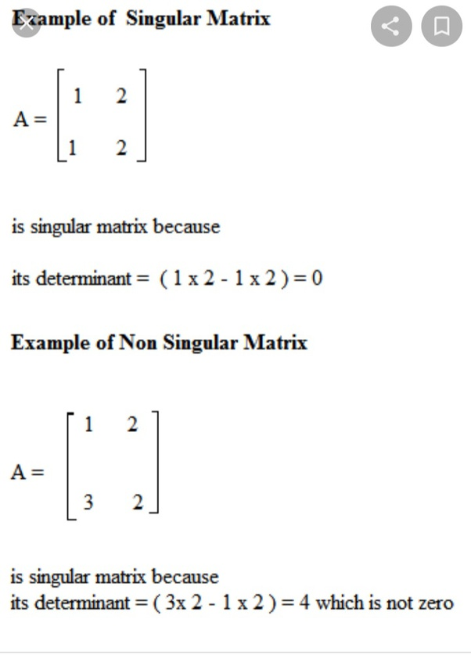
singular MAtrix
Matrix that has no inverse because its value = 0
Values of some columns or rows is zero
Have a correlation between two columns or rows
Number of rows is strictly less than number of columns.

Slide 18
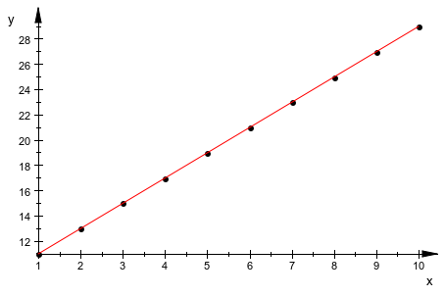
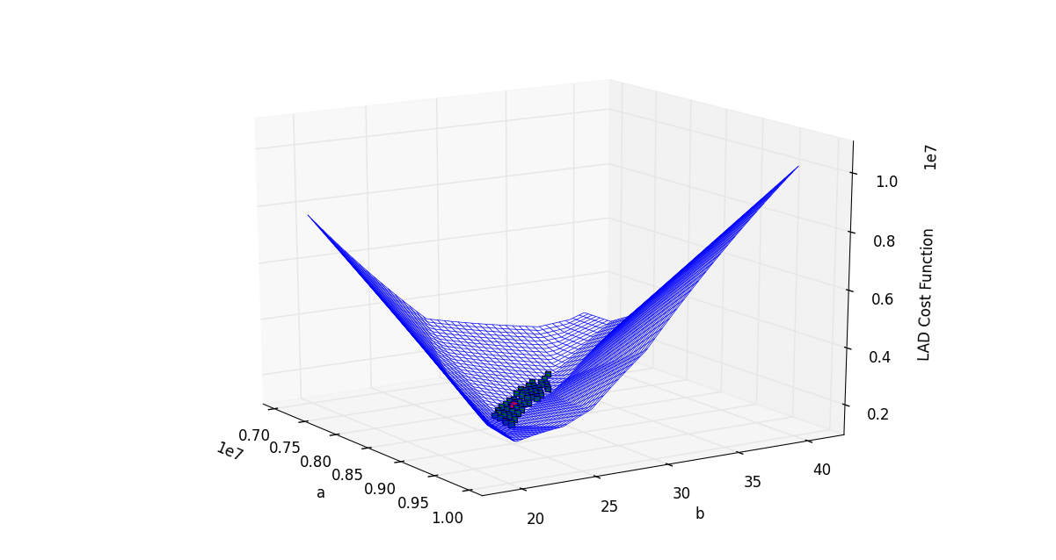
Univariate & Multi features
Dealing with one features for X
Dealing with Multi features for X
NOTE !
Next Session ^__^

